Slide 1

Beyond Classification: A Full-Stack, Dual-Model Pipeline for Plant Disease Diagnosis
An End-to-End Web Application for Actionable, In-Field Diagnostics
Chetan Mungalpara Reg. No. 12207641
Roll No. 37

Slide 2
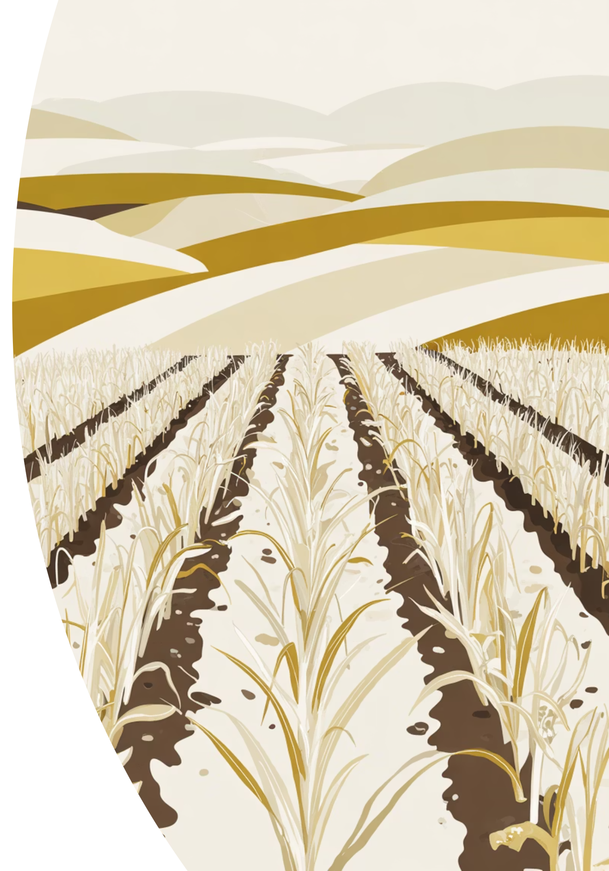
The Global Crisis: Disease Threatens Food Security
Economic Impact
The Diagnostic Gap
Plant diseases cause billions of dollars in annual crop losses worldwide, directly threatening global food security and farmer livelihoods. Early detection and rapid response are critical.
Farmers face an urgent problem: they need to know what disease is affecting their crops and how severe it is—immediately. Current methods fail to deliver both answers fast enough.

Slide 3

Two Flawed Approaches: Practical Versus Precise
Eye Inspection
Subjective, slow, labor-intensive, and unreliable—especially at early disease stages when intervention is most effective.
Laboratory Testing (PCR/ELISA)
Highly accurate but requires days, specialized equipment, trained technicians, and significant expense. Impossible for real-time field decisions.
The industry lacks a practical solution that is both fast and accurate.

Slide 4

The AI Lab-to-Field Gap
Deep learning models trained on clean, controlled laboratory datasets achieve impressive accuracy—but catastrophically fail in the real world.
99%
54%
Lab Accuracy
Field Performance
PlantVillage dataset with simple backgrounds
Real-world images collapse to half accuracy due to complex backgrounds, shadows, and variable lighting

Slide 5
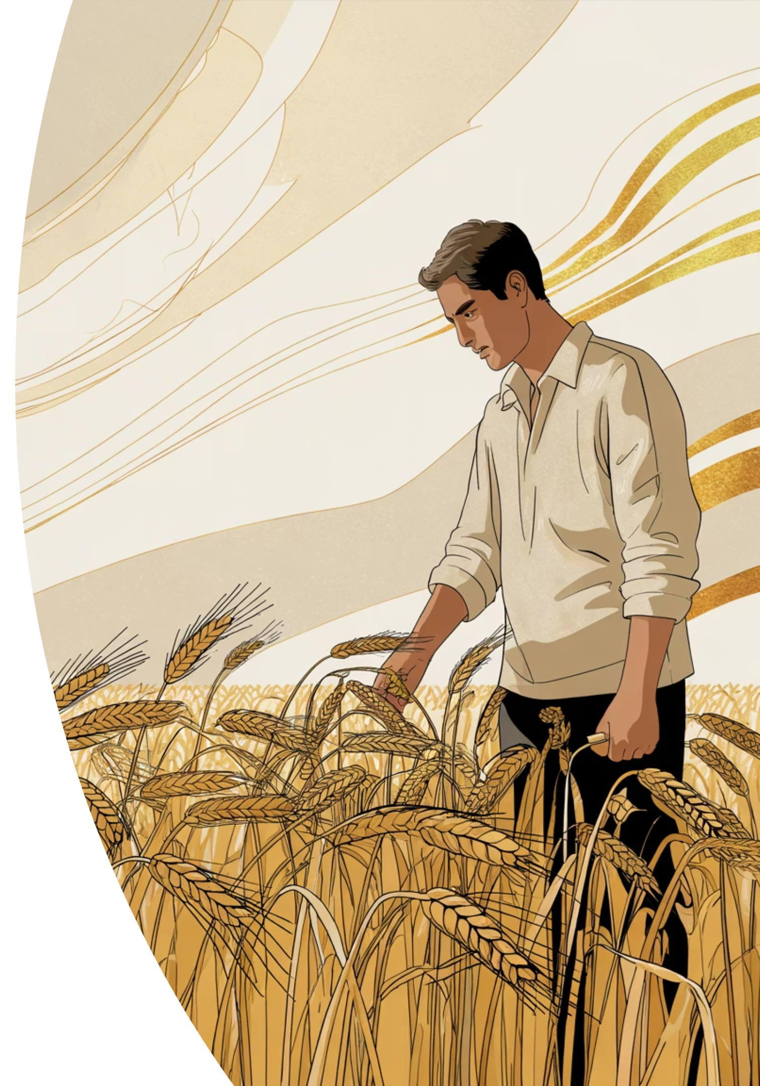

The Missing Piece: Qualitative Isn't Enough
Most AI systems answer only one question: "What disease is this?" But farmers need the other half: "How bad is it?"
Qualitative Classification
Disease identification alone provides incomplete intelligence
Quantitative Severity
Damage percentage determines action: monitor, prune, or apply costly fungicides

Slide 6

Our Solution: Dual-Model Diagnosis in One Platform
A unified web application that transforms a single leaf image into complete, actionable diagnostic intelligence through two specialized AI models working in parallel.
Disease Name
Damage Percentage
Qualitative classification identifies the exact pathogen
Quantitative severity shows the exact leaf area affected
Cure Recommendation
Actionable guidance based on disease and severity level

Slide 7
System Architecture: Parallel Processing Pipeline
A seamless end-to-end system where frontend and backend orchestrate two specialized models simultaneously to deliver results in seconds.
01
02
Frontend Input
Backend Processing
User uploads image or uses live camera capture via web browser
Flask API receives image and launches dual-model pipeline in parallel
03
04
CNN Classification
U-Net Segmentation
Disease name extracted from PlantVillage-trained model
Disease mask identifies affected pixels with precision
05
06
OpenCV Analysis
Results Delivery
Algorithm calculates total leaf area and damage percentage
Complete report displayed instantly without page reload

Slide 8

Frontend: Built for Field Use
A lightweight, responsive single-page application delivering intuitive image capture and instant diagnostic feedback in one interface.
Dual Input Methods
Dynamic Output Display
File upload for saved images
Asynchronous fetch API calls
Live camera access for immediate field diagnosis
Real-time results without reload
Built with HTML, Tailwind CSS, vanilla JavaScript
Disease mask visualization overlay
JSON response rendering

Slide 9
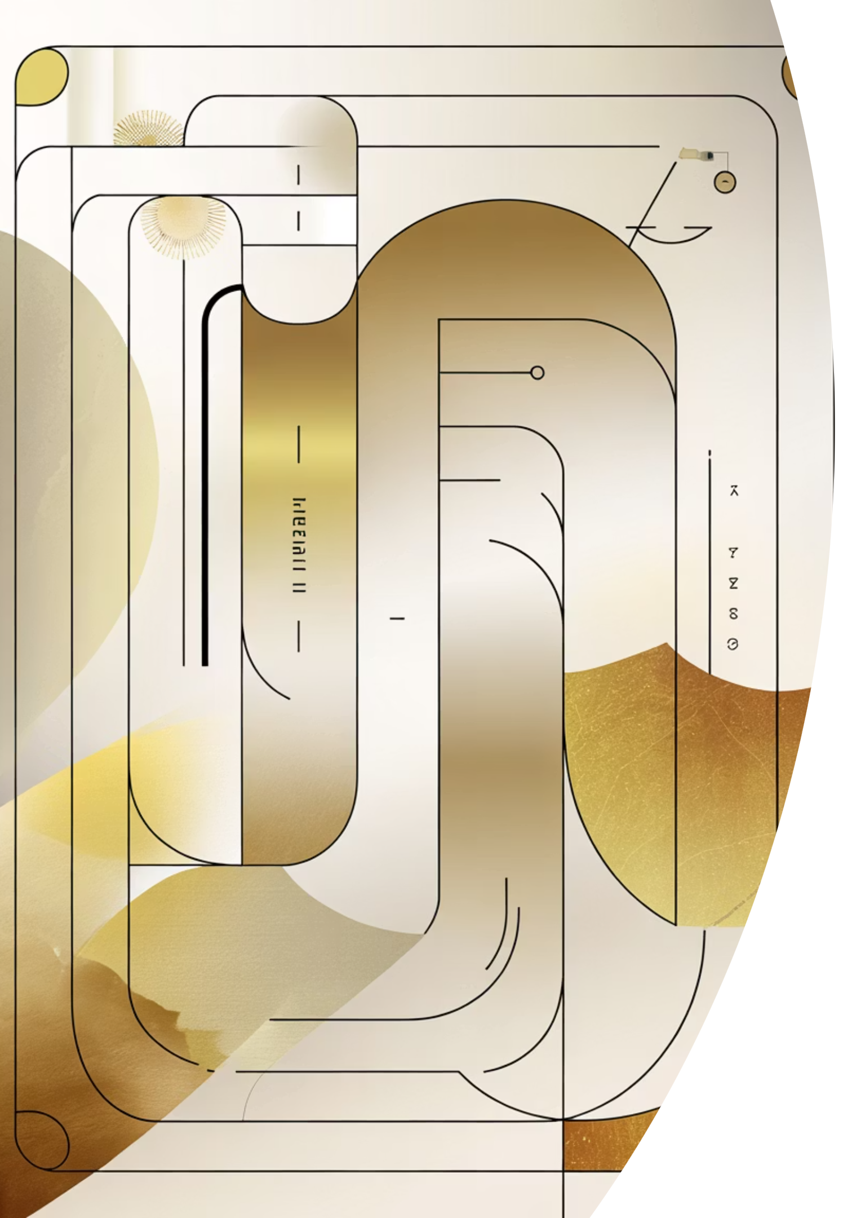
The Dual-Model Innovation: Specialization Through Architecture
Two purpose-built models work in harmony—one identifies disease, the other measures damage—creating comprehensive diagnostics from a single image.
Path 1: CNN Classification
Path 2: U-Net Segmentation
Model: Convolutional Neural Network trained on PlantVillage dataset
Model: U-Net segmentation architecture for pixel-level precision
Output: Disease mask isolating only affected leaf tissue
Output: Disease name (e.g., "Apple Scab") linked to treatment database
Performance: 88% Mean IoU, 91% Dice Coefficient
Performance: 99.39% accuracy, F1-Score 0.9934

Slide 10

From Pixels to Action: The Severity Algorithm
A three-step mathematical approach converts pixel counts into precise, objective damage percentages that drive treatment decisions.
Disease Pixels
Count white pixels from U-Net disease mask representing damaged tissue
Total Leaf Pixels
Use OpenCV Otsu's Thresholding to automatically separate entire leaf from background
Calculate Severity
Severity % = (Disease Pixels ÷ Total Leaf Pixels) × 100
Result: Objective, reproducible damage assessment that eliminates subjective guessing.

